Slide 1

CS425 – Software Engineering Project Presentation Topic: Flight Scheduling System Instructor: Prof. Obinna A. Kalu Group 3 - Team Member: Kirubel Taye (610172)
Sovichea Cheth (985421)
Charles Muchene (986817)
Lamin Saidy (610141)

Slide 2
Overview
Overview Content
Project Introduction
Use Case Diagram
Class Diagram
ER Diagram
Sequence Diagram
Tools / Frameworks
Demonstration

Slide 3
Project Introduction
Project Introduction
In a commercial airline, the flight schedule is a focal point of the planning process. It is aimed at optimizing the deployment of the airline’s resources to meet the demand and maximize profits. Having an effective and efficient resource management system like scheduling system for flight has a big role in increasing companies' profit revenue and satisfying customer’s demand on spot.
In a modern era, the technologies must match with customer's demand, especially on such management systems. Now a day's people are global citizens and work from place to place, for them to move, the preferred means of transportation is an airline industry. This industry must be modern and feature with technology for the people to uses as a delicate means of getting way to their works and purposes. The reason for building a flight schedule is to make the process smooth and comfortable and determine a concurrent flow for the passengers, cargo and aircraft.

Slide 4
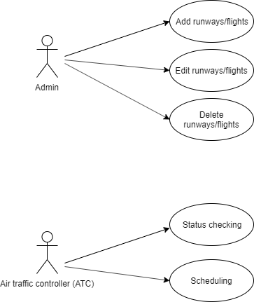
Use Case Diagram

Slide 5
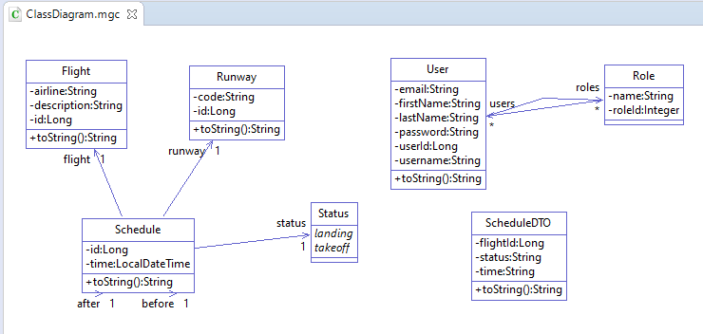
Class Diagram

Slide 6
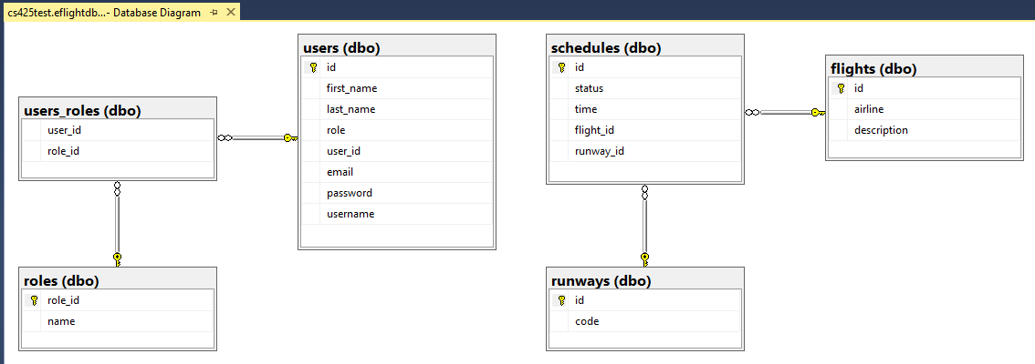
ER Diagram

Slide 7
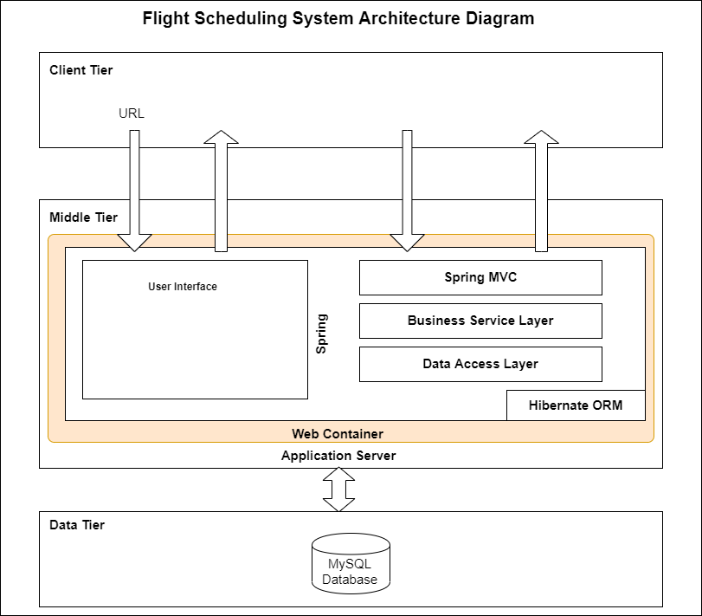
System Architecture Diagram
User Interface
Apache Kafka
Message broker
MS SQL Server DB

Slide 8
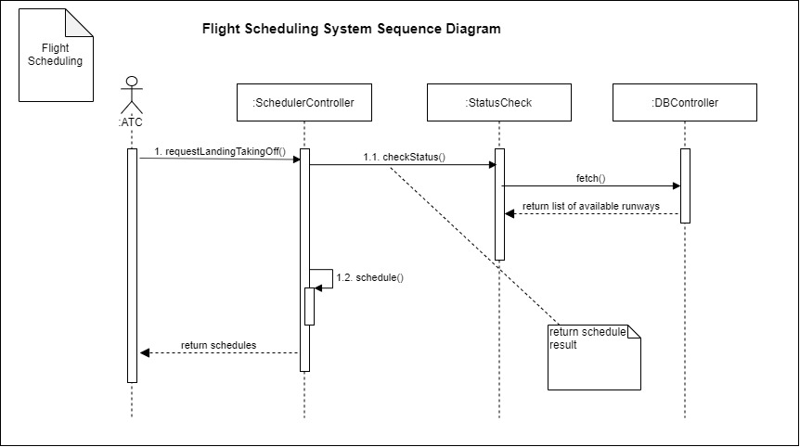
Sequence Diagram

Slide 9










Coding Techniques / Tools / Frameworks
Coding Techniques / Tools / Frameworks using on the project

Slide 10
DEMO

